Slide 1
Waiting Line Analysis for Felts Family Car Care
DSCI 4510 Group Project| Felts Family Car Care| Ashlock, J., Gallagher, J., Rizvi, A., Wijeratne, S.
Notes:
Local business that offers thorough Automotive repair services.

Slide 2

Business Summary
“Mom-and-Pop” Business
Preventative and corrective maintenance
Reputable quality, and “word-of-mouth” marketing and advertising.
Good rapport with local businesses.
Notes:
Talk about the shop, its location, services, marketing and advertising techniques, etc
-Felts Family Car Care is a “mom-and-pop” automotive repair facility located in the southeast area of Burleson, Texas.
-Perform preventative and corrective maintenance on automotive vehicles of all years, makes and models.
Ex: Preventive – Oil changes
Corrective maintenance- brake job, suspension repair
-Rely on reputable quality, and “word-of-mouth” marketing and advertising.
-Maintains good relationships with local businesses for referrals and advertising.
Ex:

Slide 3
Team Resources
Business is jointly owned and operated by a married couple
Administrative office assistant
One other mechanic
Shop hand
Notes:
Mike Felt- Husband – owner/lead Mechanic- dual role
Ruth-Wife-Office Administrator
works with administrative office assistant
One other mechanic
Shop hand or shop porter who is responsible for assisting in non technical duties such as shop cleanliness and parts requisition.

Slide 4
Tangible Resources & Technologies
Shop Resources
Utilizes universal diagnostic tools
Four full-service lifts, alignment machine, tire changing stations
Kanban system for items such as lubricants and filters
Subscription to Alldata
Shop deficiencies
Lack of IT infrastructure for operations and management of the business

Slide 5
Competitive Analysis
Automotive industry in general is highly competitive.
List of competitors within five miles:
K/C’s Auto Repair and Lube Service
Auto Center of Burleson
Christian Brothers Automotive
Dealerships
Many more….
Competitors
Most Direct Competitor: KC’s Auto Repair and Lube Service.
Same scale of business
Close in proximity
Similar services
Similar reach (based on amount of positive internet reviews)
Notes:
Strengths - Relationships from other surrounding businesses,
Weaknesses - powertrain overhauls at diagnostic level only and must be sent over to other relevant buisnesses

Slide 6
Strengths and Weaknesses
Strengths
Community reputation
Shop networking
Mechanical experience
Weaknesses
Wage competitiveness
Hybrid and fully electric vehicles

Slide 7
Administrative Line and Service Line
Administrative line
Similar to any customer front office, engages in customer service portion of the business.
Drop-off/pick-up of cars and initiation of tickets for the service line
Service Line
Operational portion of the business, handled by the technicians
Technicians update the tickets based on the job performed
Notes:
Go over differences in the lines

Slide 8
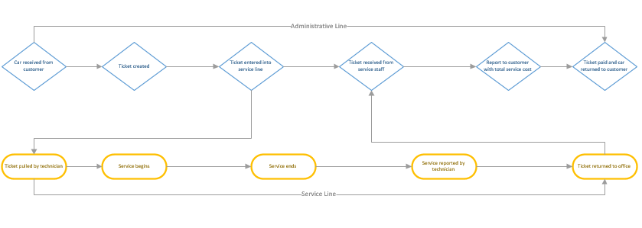
Administrative Line and Service Line, cont.

Slide 9
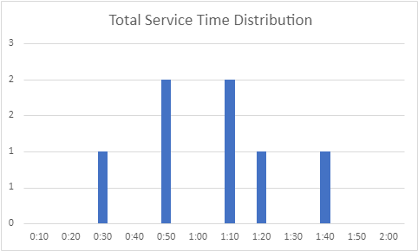
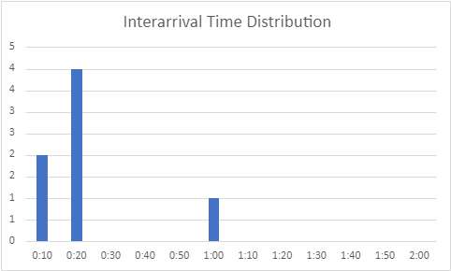
Data Collection
 | Record Date | Arrival Rate | Service Rate | Average Total Service Time | Sample St.dev | Interarrival Time | Interservice Time | Interservice St.dev | Number of servers | # of customers | # of customers served | Steady State | Record Time Start | Record Time End | Permission
Record 1 | 10/11/2021 | 1 | 0.778 | 0:59 | 0:21 | 0:17 | 0:05 | 0:03 | 2 | 7 | 7 | 1 | 10:00 AM | 5:00 PM | Yes
Record 2 | 10/12/2021 | 1.57 | 0.818 | 0:51 | 0:11 | 0:39 | 0:03 | 0:02 | 2 | 11 | 9 | 1 | 10:00 AM | 5:00 PM | Yes
Record 3 | 10/13/2021 | 1.28 | 0.889 | 1:10 | 0:25 | 0:32 | 0:04 | 0:03 | 2 | 9 | 8 | 1 | 10:00 AM | 5:00 PM | Yes
Avg of 3 sample days |  | 1.283 | 0.828 | 1:00 | 0:19 | 0:29 | 0:04 | 0:03

Slide 10
Observation Summary
Felts Family Car Care
Parameters
Operating Hours | 9 | hrs
Operating Hours in Minutes | 540 | min
Service Rate / hr | 0.828 | cars
Arrival Rate / hr | 1.283 | cars
Total Service Time (Normal)
Mean | 60 | min
St.Dev | 19 | min
Interarrival Time (Exponential)
Mean | 29 | min
Service Processing Time (Uniform)
Range | 5-10 | min
Number of Servers | 2

Slide 11
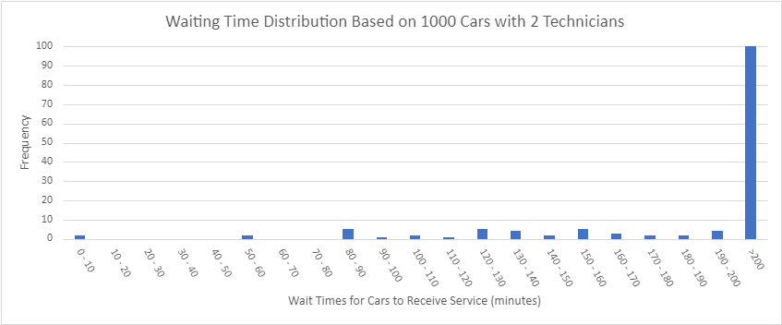
Simulation for 2 Technician Service Line
Simulation Summary Statistics
Cars Serviced | 14 | cars
Number Waiting (Lq) | 12 | cars
Probability of Waiting (Pw) | 85.71%
Average Wait Time (Wq) | 105.29 | min
Maximum Wait Time | 189.03 | min
Number of Cars With 0 Wait | 2 | cars
Probability of No Wait (p0) | 14.29%
Average number of cars in system (L) | 14 | cars
Average time in system (W) | 179.32 | min
Tech 1 Utilization | 50%
Tech 2 Utilization | 50%

Slide 12
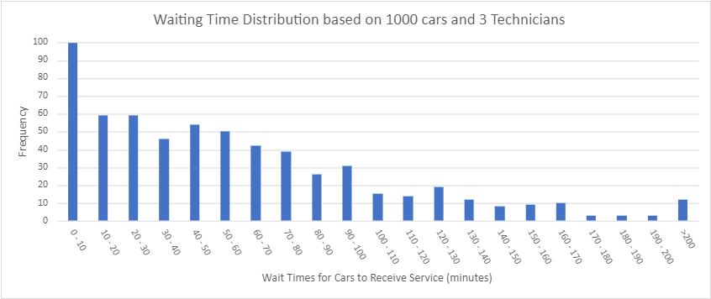
Simulation for 3 Technician Service Line
Simulation Summary Statistics
Cars Serviced | 15 | cars
Number Waiting (Lq) | 7 | cars
Probability of Waiting (Pw) | 46.67%
Average Wait Time (Wq) | 15.88 | min
Maximum Wait Time | 57.82 | min
Number of Cars With 0 Wait | 8 | cars
Probability of No Wait (p0) | 53.33%
Average number of cars in system (L) | 9 | cars
Average time in system (W) | 83.96 | min
Tech 1 Utilization | 33%
Tech 2 Utilization | 33%
Tech 3 Utilization | 34%

Slide 13
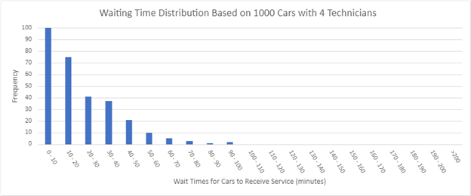
Simulation for 4 Technician Service Line
Simulation Summary Statistics
Cars Serviced | 14 | cars
Number Waiting (Lq) | 4 | cars
Probability of Waiting (Pw) | 28.57%
Average Wait Time (Wq) | 6.96 | min
Maximum Wait Time | 62.41 | min
Number of Cars With 0 Wait | 10 | cars
Probability of No Wait (p0) | 71.43%
Average number of cars in system (L) | 6 | cars
Average time in system (W) | 77.78 | min
Tech 1 Utilization | 25%
Tech 2 Utilization | 25%
Tech 3 Utilization | 24%
Tech 4 Utilization | 25%

Slide 14
Simulation
Felts Family Car Care Data Sheet

Slide 15
Summary Statistics
Simulation Summary Statistics
Cars Serviced | 14 | 15 | 14 | cars
Number Waiting (Lq) | 12 | 7 | 4 | cars
Probability of Waiting (Pw) | 85.71% | 46.67% | 28.57%
Average Wait Time (Wq) | 105.29 | 15.88 | 6.96 | min
Maximum Wait Time | 189.03 | 57.82 | 62.41 | min
Number of Cars With 0 Wait | 2 | 8 | 10 | cars
Probability of No Wait (p0) | 14.29% | 53.33% | 71.43%
Average number of cars in system (L) | 14 | 9 | 6 | cars
Average time in system (W) | 179.32 | 83.96 | 77.78 | min
Tech 1 Utilization | 50% | 33% | 25%
Tech 2 Utilization | 50% | 33% | 25%
Tech 1 Utilization |  | 34% | 24%
Tech 2 Utilization |  |  | 25%
* Notice the inverse relationship between the waiting times/units and the number of technicians

Slide 16
Recommendations
Benefits of the three-technician model over the two-technician model
Need more data to recommend the four-technician model
Increased marketing, or technological needs, may increase need to move to the four-technician model

Slide 17
THANK YOU

